Slide 1
Paper2 result
林奇鋒

Slide 2
Experimentation1

Slide 3
Data
Experimentation1
Experimentation1
 | Training | Testing
NASDAQ opening | 01/03/2007~12/26/2008 | 12/29/2008~12/20/2010
NASDAQ closing | 01/03/2007~12/26/2008 | 12/29/2008~12/20/2010
SP500 opening | 01/03/2007~12/26/2008 | 12/29/2008~12/20/2010
SP500 closing | 01/03/2007~12/26/2008 | 12/29/2008~12/20/2010
500
500

Slide 4
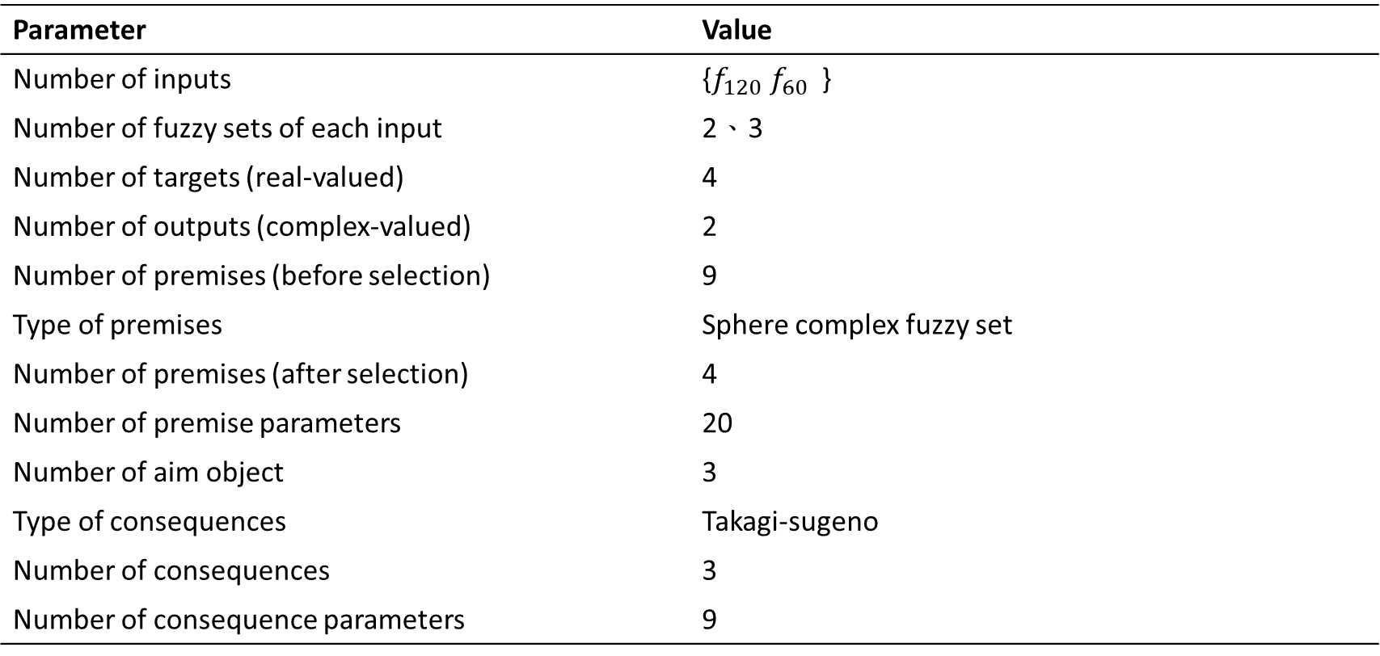
Result
Experimentation1
Parameter | Value
Number of inputs | {$f_{120} f_{60}$ }
Number of fuzzy sets of each input | 2、3
Number of targets (real-valued) | 4
Number of outputs (complex-valued) | 2
Number of premises (before selection) | 9
Type of premises | Sphere complex fuzzy set
Number of premises (after selection) | 4
Number of premise parameters | 20
Number of aim object | 3
Type of consequences | Takagi-sugeno
Number of consequences | 3
Number of consequence parameters | 9

Slide 5
Experimentation1
PSO parameters
Parameters | value
Swarm size | 64
Iterations | 100
$ω c_{1} 、c_{2}$ | 0.8 2.0 2.0
$ξ_{1}、ξ_{2}$ | Random in [0,1]
Velocity | 0
RLSE parameters
Parameters | value
$α$ | ${1×10}^{8}$
${\overset{⃑}{\text{θ}}}_{0}$ | 20x1 zero vector
$P_{0}$ | $α$I
I | 20x20 identify matrix

Slide 6
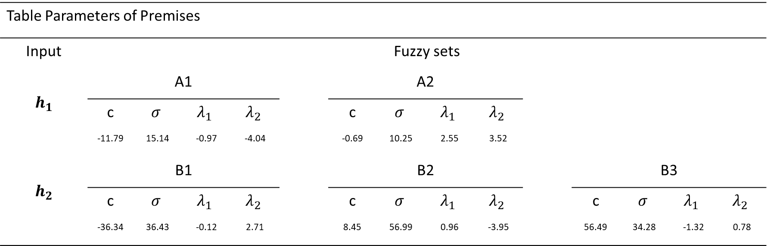
Premises Parameters (after learning)
Experimentation1
Table Parameters of Premises
Input | Fuzzy sets
$$h_{1}$$ | A1 |  |  |  |  | A2
 | c | $$σ$$ | $$λ_{1}$$ | $$λ_{2}$$ |  | c | $$σ$$ | $$λ_{1}$$ | $$λ_{2}$$
 | -11.79 | 15.14 | -0.97 | -4.04 |  | -0.69 | 10.25 | 2.55 | 3.52
$$h_{2}$$ | B1 |  |  |  |  | B2 |  |  |  |  | B3
 | c | $$σ$$ | $$λ_{1}$$ | $$λ_{2}$$ |  | c | $$σ$$ | $$λ_{1}$$ | $$λ_{2}$$ |  | c | $$σ$$ | $$λ_{1}$$ | $$λ_{2}$$
 | -36.34 | 36.43 | -0.12 | 2.71 |  | 8.45 | 56.99 | 0.96 | -3.95 |  | 56.49 | 34.28 | -1.32 | 0.78

Slide 7
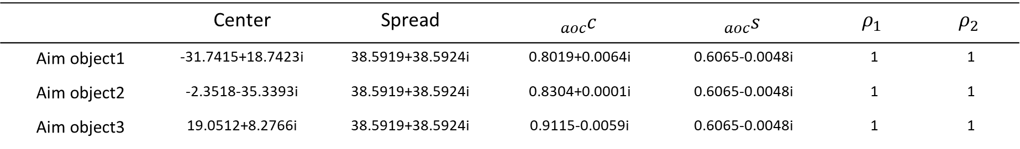
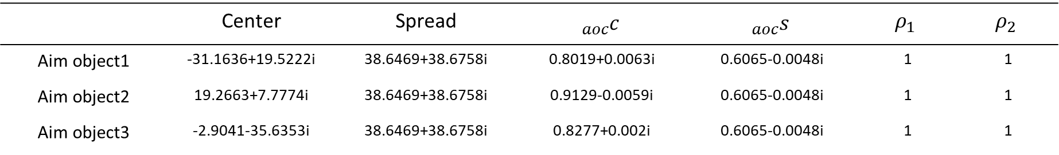
Aim Object Parameters
Layer1 of Aim Object
 | Center | Spread | $${}_{aoc}^{}c$$ | $${}_{aoc}^{}s$$ | $$ρ_{1}$$ | $$ρ_{2}$$
Aim object1 | -31.7415+18.7423i | 38.5919+38.5924i | 0.8019+0.0064i | 0.6065-0.0048i | 1 | 1
Aim object2 | -2.3518-35.3393i | 38.5919+38.5924i | 0.8304+0.0001i | 0.6065-0.0048i | 1 | 1
Aim object3 | 19.0512+8.2766i | 38.5919+38.5924i | 0.9115-0.0059i | 0.6065-0.0048i | 1 | 1
Layer2 of Aim Object
 | Center | Spread | $${}_{aoc}^{}c$$ | $${}_{aoc}^{}s$$ | $$ρ_{1}$$ | $$ρ_{2}$$
Aim object1 | -31.1636+19.5222i | 38.6469+38.6758i | 0.8019+0.0063i | 0.6065-0.0048i | 1 | 1
Aim object2 | 19.2663+7.7774i | 38.6469+38.6758i | 0.9129-0.0059i | 0.6065-0.0048i | 1 | 1
Aim object3 | -2.9041-35.6353i | 38.6469+38.6758i | 0.8277+0.002i | 0.6065-0.0048i | 1 | 1
Notes:
Radius:
0.0626
0.9724
0.6032
0.9479
0.3660

Slide 8
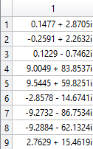
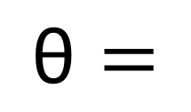
Consequences Parameters
$$\text{θ}=$$

Slide 9
Learning Curve
Experimentation1

Slide 10
Experimentation1

Slide 11
Comparison
Experimentation1
Method | RMSE
 | Training phase |  |  | Testing phase
 | Opening index | Closing index |  | Opening index | Closing index
SVR (two models, each with single output) | 35.18 | 35.24 |  | 37.23 | 40.24
ANFIS (two models, each with single output) | 37.83 | 38.66 |  | 38.80 | 42.36
ANFIS (one model with two output) | 62.75 | 71.51 |  | 72.52 | 85.08
RBF (two models, each with single output) | 37.59 | 33.89 |  | 37.52 | 44.08
RBF (one model with two output) | 178.57 | 179.87 |  | 261.37 | 258.89
CNFS(5)-ARIMA (one model with two output) | 21.56 | 20.81 |  | 32.52 | 33.70
SCNFS(one model with four output) | 38.58 | 38.59 |  | 27.79 | 27.83

Slide 12
Experimentation2

Slide 13
Introduction
Experimentation2
此實驗對TAIEX、DJAI、NASDAQ、SP500做預測
總共跑四次模型:
用上述四組2001年的收盤價跑一次模型
用上述四組2002年的收盤價跑一次模型
用上述四組2003年的收盤價跑一次模型
用上述四組2004年的收盤價跑一次模型

Slide 14
Data
Experimentation2
Experimentation2_2001
 | Training | Testing
TAIEX | 01/01/2001~9/30/2001 | 10/01/2001~12/31/2001
DJAI | 01/05/2001~9/30/2001 | 10/01/2001~01/03/2002
NASDAQ | 01/05/2001~9/30/2001 | 10/01/2001~01/03/2002
S&P500 | 01/05/2001~9/30/2001 | 10/01/2001~01/03/2002
181
64

Slide 15

Result
Experimentation2
Parameter | Value
Number of inputs | {$f_{97} f_{3} f_{120} f_{4}$ }
Number of fuzzy sets of each input | 3、4、3、4
Number of targets (real-valued) | 4
Number of outputs (complex-valued) | 2
Number of premises (before selection) | 144
Type of premises | Sphere complex fuzzy set
Number of premises (after selection) | 15
Number of premise parameters | 56
Number of aim object | 3
Type of consequences | Takagi-sugeno
Number of consequences | 3
Number of consequence parameters | 15

Slide 16
Experimentation2
PSO parameters
Parameters | value
Swarm size | 64
Iterations | 100
$ω c_{1} 、c_{2}$ | 0.8 2.0 2.0
$ξ_{1}、ξ_{2}$ | Random in [0,1]
Velocity | 0
RLSE parameters
Parameters | value
$α$ | ${1×10}^{8}$
${\overset{⃑}{\text{θ}}}_{0}$ | 20x1 zero vector
$P_{0}$ | $α$I
I | 20x20 identify matrix

Slide 17
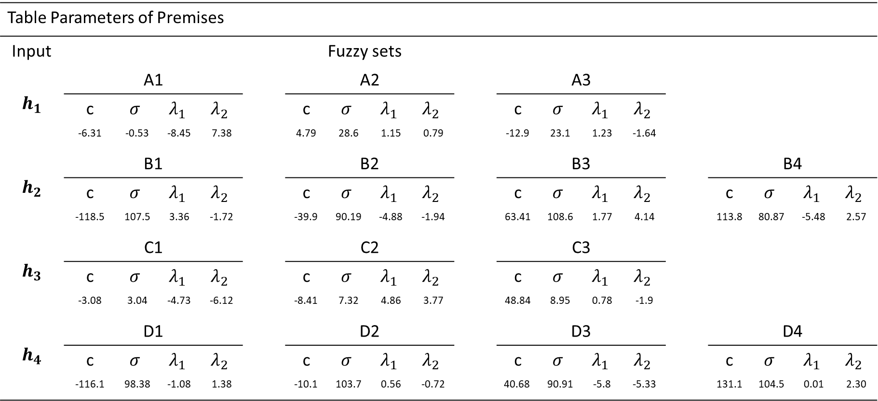
Premises Parameters (after learning)
Experimentation2
Table Parameters of Premises
Input | Fuzzy sets
$$h_{1}$$ | A1 |  |  |  |  | A2 |  |  |  |  | A3
 | c | $$σ$$ | $$λ_{1}$$ | $$λ_{2}$$ |  | c | $$σ$$ | $$λ_{1}$$ | $$λ_{2}$$ |  | c | $$σ$$ | $$λ_{1}$$ | $$λ_{2}$$
 | -6.31 | -0.53 | -8.45 | 7.38 |  | 4.79 | 28.6 | 1.15 | 0.79 |  | -12.9 | 23.1 | 1.23 | -1.64
$$h_{2}$$ | B1 |  |  |  |  | B2 |  |  |  |  | B3 |  |  |  |  | B4
 | c | $$σ$$ | $$λ_{1}$$ | $$λ_{2}$$ |  | c | $$σ$$ | $$λ_{1}$$ | $$λ_{2}$$ |  | c | $$σ$$ | $$λ_{1}$$ | $$λ_{2}$$ |  | c | $$σ$$ | $$λ_{1}$$ | $$λ_{2}$$
 | -118.5 | 107.5 | 3.36 | -1.72 |  | -39.9 | 90.19 | -4.88 | -1.94 |  | 63.41 | 108.6 | 1.77 | 4.14 |  | 113.8 | 80.87 | -5.48 | 2.57
$$h_{3}$$ | C1 |  |  |  |  | C2 |  |  |  |  | C3
 | c | $$σ$$ | $$λ_{1}$$ | $$λ_{2}$$ |  | c | $$σ$$ | $$λ_{1}$$ | $$λ_{2}$$ |  | c | $$σ$$ | $$λ_{1}$$ | $$λ_{2}$$
 | -3.08 | 3.04 | -4.73 | -6.12 |  | -8.41 | 7.32 | 4.86 | 3.77 |  | 48.84 | 8.95 | 0.78 | -1.9
$$h_{4}$$ | D1 |  |  |  |  | D2 |  |  |  |  | D3 |  |  |  |  | D4
 | c | $$σ$$ | $$λ_{1}$$ | $$λ_{2}$$ |  | c | $$σ$$ | $$λ_{1}$$ | $$λ_{2}$$ |  | c | $$σ$$ | $$λ_{1}$$ | $$λ_{2}$$ |  | c | $$σ$$ | $$λ_{1}$$ | $$λ_{2}$$
 | -116.1 | 98.38 | -1.08 | 1.38 |  | -10.1 | 103.7 | 0.56 | -0.72 |  | 40.68 | 90.91 | -5.8 | -5.33 |  | 131.1 | 104.5 | 0.01 | 2.30

Slide 18
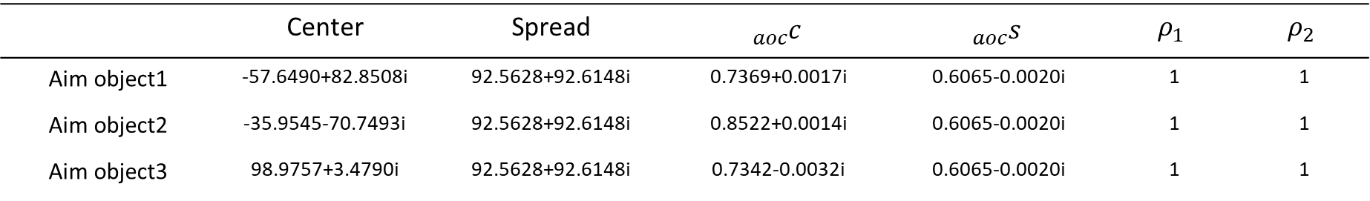
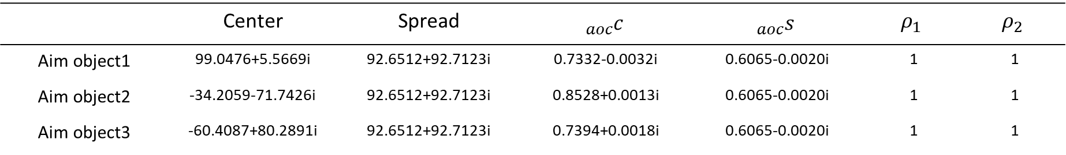
Aim Object Parameters
Layer1 of Aim Object
 | Center | Spread | $${}_{aoc}^{}c$$ | $${}_{aoc}^{}s$$ | $$ρ_{1}$$ | $$ρ_{2}$$
Aim object1 | -57.6490+82.8508i | 92.5628+92.6148i | 0.7369+0.0017i | 0.6065-0.0020i | 1 | 1
Aim object2 | -35.9545-70.7493i | 92.5628+92.6148i | 0.8522+0.0014i | 0.6065-0.0020i | 1 | 1
Aim object3 | 98.9757+3.4790i | 92.5628+92.6148i | 0.7342-0.0032i | 0.6065-0.0020i | 1 | 1
Layer2 of Aim Object
 | Center | Spread | $${}_{aoc}^{}c$$ | $${}_{aoc}^{}s$$ | $$ρ_{1}$$ | $$ρ_{2}$$
Aim object1 | 99.0476+5.5669i | 92.6512+92.7123i | 0.7332-0.0032i | 0.6065-0.0020i | 1 | 1
Aim object2 | -34.2059-71.7426i | 92.6512+92.7123i | 0.8528+0.0013i | 0.6065-0.0020i | 1 | 1
Aim object3 | -60.4087+80.2891i | 92.6512+92.7123i | 0.7394+0.0018i | 0.6065-0.0020i | 1 | 1
Notes:
Radius:
0.0626
0.9724
0.6032
0.9479
0.3660

Slide 19
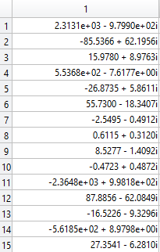
Consequences Parameters
$$\text{θ}=$$

Slide 20
Learning Curve
Experimentation2

Slide 21
Experimentation2

Slide 22
Data
Experimentation2
Experimentation2_2002
 | Training | Testing
TAIEX | 01/01/2002~9/30/2002 | 10/01/2002~12/31/2002
DJAI | 01/07/2002~9/30/2002 | 10/01/2002~01/03/2003
NASDAQ | 01/07/2002~9/30/2002 | 10/01/2002~01/03/2003
S&P500 | 01/07/2002~9/30/2002 | 10/01/2002~01/03/2003
184
64

Slide 23

Result
Experimentation2
Parameter | Value
Number of inputs | {$f_{120} f_{114} f_{87} f_{82}$ }
Number of fuzzy sets of each input | 3、3、3、3
Number of targets (real-valued) | 4
Number of outputs (complex-valued) | 2
Number of premises (before selection) | 81
Type of premises | Sphere complex fuzzy set
Number of premises (after selection) | 13
Number of premise parameters | 48
Number of aim object | 5
Type of consequences | Takagi-sugeno
Number of consequences | 5
Number of consequence parameters | 25

Slide 24
Experimentation2
PSO parameters
Parameters | value
Swarm size | 64
Iterations | 100
$ω c_{1} 、c_{2}$ | 0.8 2.0 2.0
$ξ_{1}、ξ_{2}$ | Random in [0,1]
Velocity | 0
RLSE parameters
Parameters | value
$α$ | ${1×10}^{8}$
${\overset{⃑}{\text{θ}}}_{0}$ | 20x1 zero vector
$P_{0}$ | $α$I
I | 20x20 identify matrix

Slide 25
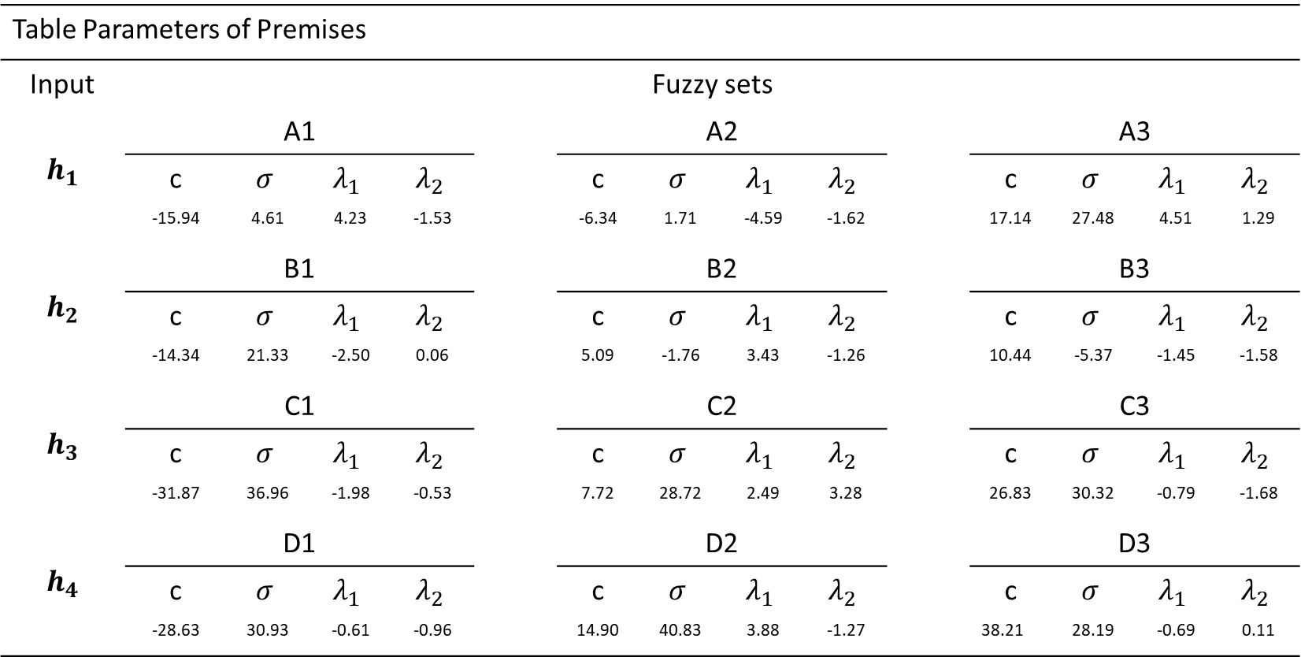
Premises Parameters (after learning)
Experimentation2
Table Parameters of Premises
Input | Fuzzy sets
$$h_{1}$$ | A1 |  |  |  |  | A2 |  |  |  |  | A3
 | c | $$σ$$ | $$λ_{1}$$ | $$λ_{2}$$ |  | c | $$σ$$ | $$λ_{1}$$ | $$λ_{2}$$ |  | c | $$σ$$ | $$λ_{1}$$ | $$λ_{2}$$
 | -15.94 | 4.61 | 4.23 | -1.53 |  | -6.34 | 1.71 | -4.59 | -1.62 |  | 17.14 | 27.48 | 4.51 | 1.29
$$h_{2}$$ | B1 |  |  |  |  | B2 |  |  |  |  | B3
 | c | $$σ$$ | $$λ_{1}$$ | $$λ_{2}$$ |  | c | $$σ$$ | $$λ_{1}$$ | $$λ_{2}$$ |  | c | $$σ$$ | $$λ_{1}$$ | $$λ_{2}$$
 | -14.34 | 21.33 | -2.50 | 0.06 |  | 5.09 | -1.76 | 3.43 | -1.26 |  | 10.44 | -5.37 | -1.45 | -1.58
$$h_{3}$$ | C1 |  |  |  |  | C2 |  |  |  |  | C3
 | c | $$σ$$ | $$λ_{1}$$ | $$λ_{2}$$ |  | c | $$σ$$ | $$λ_{1}$$ | $$λ_{2}$$ |  | c | $$σ$$ | $$λ_{1}$$ | $$λ_{2}$$
 | -31.87 | 36.96 | -1.98 | -0.53 |  | 7.72 | 28.72 | 2.49 | 3.28 |  | 26.83 | 30.32 | -0.79 | -1.68
$$h_{4}$$ | D1 |  |  |  |  | D2 |  |  |  |  | D3
 | c | $$σ$$ | $$λ_{1}$$ | $$λ_{2}$$ |  | c | $$σ$$ | $$λ_{1}$$ | $$λ_{2}$$ |  | c | $$σ$$ | $$λ_{1}$$ | $$λ_{2}$$
 | -28.63 | 30.93 | -0.61 | -0.96 |  | 14.90 | 40.83 | 3.88 | -1.27 |  | 38.21 | 28.19 | -0.69 | 0.11

Slide 26
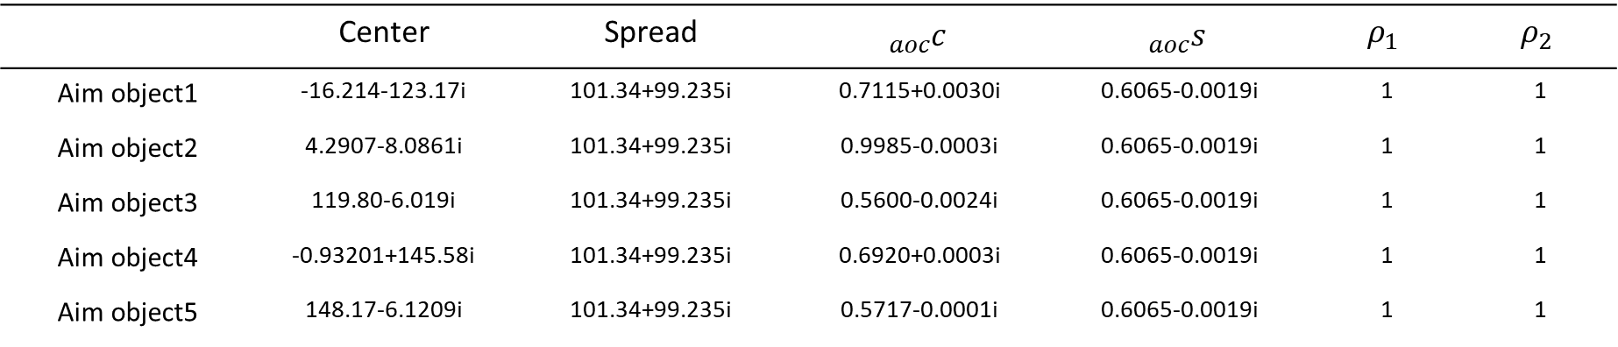
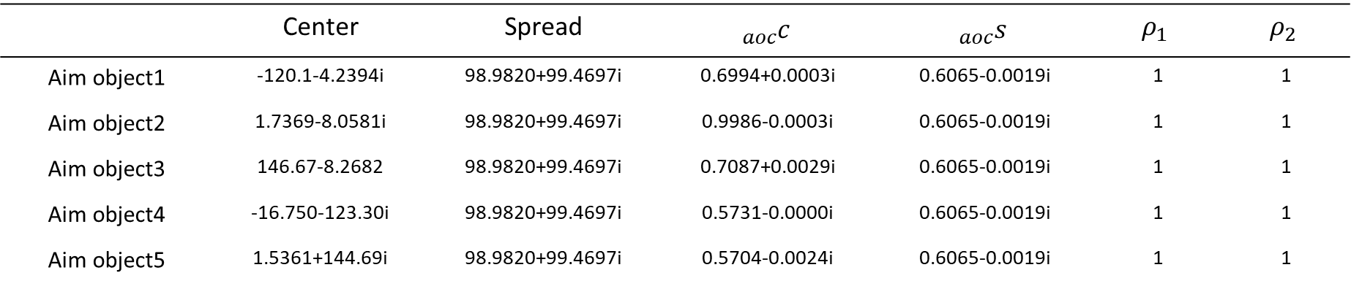
Aim Object Parameters
Layer1 of Aim Object
 | Center | Spread | $${}_{aoc}^{}c$$ | $${}_{aoc}^{}s$$ | $$ρ_{1}$$ | $$ρ_{2}$$
Aim object1 | -16.214-123.17i | 101.34+99.235i | 0.7115+0.0030i | 0.6065-0.0019i | 1 | 1
Aim object2 | 4.2907-8.0861i | 101.34+99.235i | 0.9985-0.0003i | 0.6065-0.0019i | 1 | 1
Aim object3 | 119.80-6.019i | 101.34+99.235i | 0.5600-0.0024i | 0.6065-0.0019i | 1 | 1
Aim object4 | -0.93201+145.58i | 101.34+99.235i | 0.6920+0.0003i | 0.6065-0.0019i | 1 | 1
Aim object5 | 148.17-6.1209i | 101.34+99.235i | 0.5717-0.0001i | 0.6065-0.0019i | 1 | 1
Layer2 of Aim Object
 | Center | Spread | $${}_{aoc}^{}c$$ | $${}_{aoc}^{}s$$ | $$ρ_{1}$$ | $$ρ_{2}$$
Aim object1 | -120.1-4.2394i | 98.9820+99.4697i | 0.6994+0.0003i | 0.6065-0.0019i | 1 | 1
Aim object2 | 1.7369-8.0581i | 98.9820+99.4697i | 0.9986-0.0003i | 0.6065-0.0019i | 1 | 1
Aim object3 | 146.67-8.2682 | 98.9820+99.4697i | 0.7087+0.0029i | 0.6065-0.0019i | 1 | 1
Aim object4 | -16.750-123.30i | 98.9820+99.4697i | 0.5731-0.0000i | 0.6065-0.0019i | 1 | 1
Aim object5 | 1.5361+144.69i | 98.9820+99.4697i | 0.5704-0.0024i | 0.6065-0.0019i | 1 | 1
Notes:
Radius:
0.0626
0.9724
0.6032
0.9479
0.3660

Slide 27
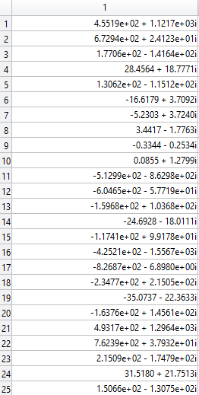
Consequences Parameters
$$\text{θ}=$$

Slide 28
Learning Curve
Experimentation2

Slide 29
Experimentation2

Slide 30
Data
Experimentation2
Experimentation2_2003
 | Training | Testing
TAIEX | 01/01/2003~09/30/2003 | 10/01/2003~12/31/2003
DJAI | 01/05/2003~09/30/2003 | 10/01/2003~01/05/2004
NASDAQ | 01/05/2003~09/30/2003 | 10/01/2003~01/05/2004
S&P500 | 01/05/2003~09/30/2003 | 10/01/2003~01/05/2004
185
64

Slide 31

Result
Experimentation2
Parameter | Value
Number of inputs | {$f_{26} f_{44} f_{36} f_{46}$ }
Number of fuzzy sets of each input | 3、3、3、3
Number of targets (real-valued) | 4
Number of outputs (complex-valued) | 2
Number of premises (before selection) | 81
Type of premises | Sphere complex fuzzy set
Number of premises (after selection) | 11
Number of premise parameters | 48
Number of aim object | 3
Type of consequences | Takagi-sugeno
Number of consequences | 3
Number of consequence parameters | 15

Slide 32
Experimentation2
PSO parameters
Parameters | value
Swarm size | 64
Iterations | 100
$ω c_{1} 、c_{2}$ | 0.8 2.0 2.0
$ξ_{1}、ξ_{2}$ | Random in [0,1]
Velocity | 0
RLSE parameters
Parameters | value
$α$ | ${1×10}^{8}$
${\overset{⃑}{\text{θ}}}_{0}$ | 20x1 zero vector
$P_{0}$ | $α$I
I | 20x20 identify matrix

Slide 33
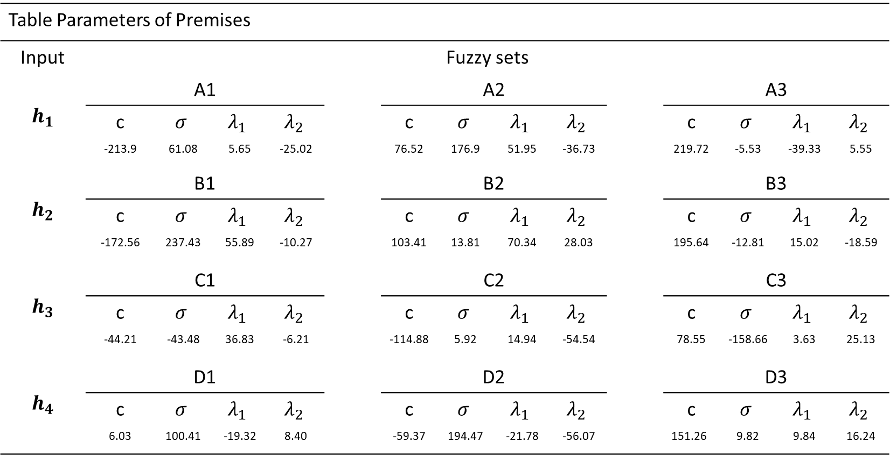
Premises Parameters (after learning)
Experimentation2
Table Parameters of Premises
Input | Fuzzy sets
$$h_{1}$$ | A1 |  |  |  |  | A2 |  |  |  |  | A3
 | c | $$σ$$ | $$λ_{1}$$ | $$λ_{2}$$ |  | c | $$σ$$ | $$λ_{1}$$ | $$λ_{2}$$ |  | c | $$σ$$ | $$λ_{1}$$ | $$λ_{2}$$
 | -213.9 | 61.08 | 5.65 | -25.02 |  | 76.52 | 176.9 | 51.95 | -36.73 |  | 219.72 | -5.53 | -39.33 | 5.55
$$h_{2}$$ | B1 |  |  |  |  | B2 |  |  |  |  | B3
 | c | $$σ$$ | $$λ_{1}$$ | $$λ_{2}$$ |  | c | $$σ$$ | $$λ_{1}$$ | $$λ_{2}$$ |  | c | $$σ$$ | $$λ_{1}$$ | $$λ_{2}$$
 | -172.56 | 237.43 | 55.89 | -10.27 |  | 103.41 | 13.81 | 70.34 | 28.03 |  | 195.64 | -12.81 | 15.02 | -18.59
$$h_{3}$$ | C1 |  |  |  |  | C2 |  |  |  |  | C3
 | c | $$σ$$ | $$λ_{1}$$ | $$λ_{2}$$ |  | c | $$σ$$ | $$λ_{1}$$ | $$λ_{2}$$ |  | c | $$σ$$ | $$λ_{1}$$ | $$λ_{2}$$
 | -44.21 | -43.48 | 36.83 | -6.21 |  | -114.88 | 5.92 | 14.94 | -54.54 |  | 78.55 | -158.66 | 3.63 | 25.13
$$h_{4}$$ | D1 |  |  |  |  | D2 |  |  |  |  | D3
 | c | $$σ$$ | $$λ_{1}$$ | $$λ_{2}$$ |  | c | $$σ$$ | $$λ_{1}$$ | $$λ_{2}$$ |  | c | $$σ$$ | $$λ_{1}$$ | $$λ_{2}$$
 | 6.03 | 100.41 | -19.32 | 8.40 |  | -59.37 | 194.47 | -21.78 | -56.07 |  | 151.26 | 9.82 | 9.84 | 16.24

Slide 34
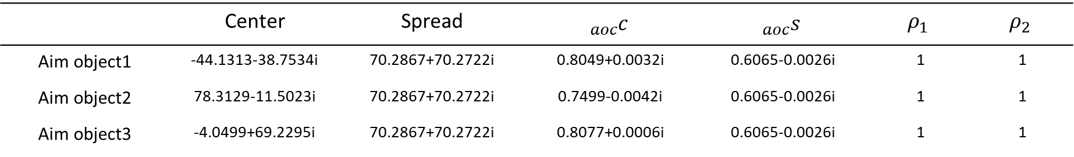
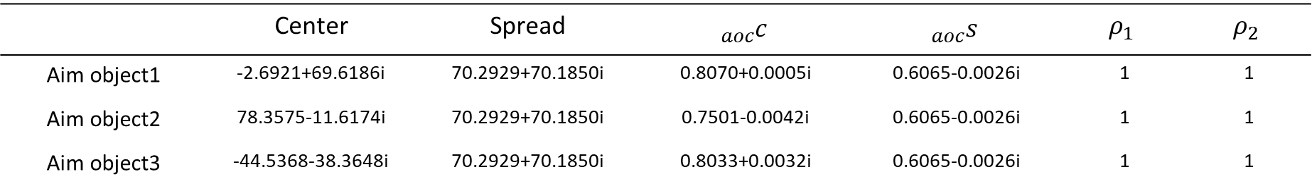
Aim Object Parameters
Layer1 of Aim Object
 | Center | Spread | $${}_{aoc}^{}c$$ | $${}_{aoc}^{}s$$ | $$ρ_{1}$$ | $$ρ_{2}$$
Aim object1 | -44.1313-38.7534i | 70.2867+70.2722i | 0.8049+0.0032i | 0.6065-0.0026i | 1 | 1
Aim object2 | 78.3129-11.5023i | 70.2867+70.2722i | 0.7499-0.0042i | 0.6065-0.0026i | 1 | 1
Aim object3 | -4.0499+69.2295i | 70.2867+70.2722i | 0.8077+0.0006i | 0.6065-0.0026i | 1 | 1
Layer2 of Aim Object
 | Center | Spread | $${}_{aoc}^{}c$$ | $${}_{aoc}^{}s$$ | $$ρ_{1}$$ | $$ρ_{2}$$
Aim object1 | -2.6921+69.6186i | 70.2929+70.1850i | 0.8070+0.0005i | 0.6065-0.0026i | 1 | 1
Aim object2 | 78.3575-11.6174i | 70.2929+70.1850i | 0.7501-0.0042i | 0.6065-0.0026i | 1 | 1
Aim object3 | -44.5368-38.3648i | 70.2929+70.1850i | 0.8033+0.0032i | 0.6065-0.0026i | 1 | 1
Notes:
Radius:
0.0626
0.9724
0.6032
0.9479
0.3660

Slide 35
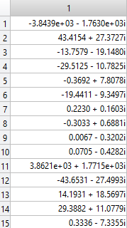
Consequences Parameters
$$\text{θ}=$$

Slide 36
Learning Curve
Experimentation2

Slide 37
Experimentation2

Slide 38
Data
Experimentation2
Experimentation2_2004
 | Training | Testing
TAIEX | 01/01/2004~09/30/2004 | 10/01/2004~12/31/2004
DJAI | 01/04/2004~09/30/2004 | 10/01/2004~01/04/2005
NASDAQ | 01/04/2004~09/30/2004 | 10/01/2004~01/04/2005
S&P500 | 01/04/2004~09/30/2004 | 10/01/2004~01/04/2005
185
65

Slide 39

Result
Experimentation2
Parameter | Value
Number of inputs | {$f_{80} f_{74} f_{82} f_{73}$ }
Number of fuzzy sets of each input | 5、4、4、4
Number of targets (real-valued) | 4
Number of outputs (complex-valued) | 2
Number of premises (before selection) | 320
Type of premises | Sphere complex fuzzy set
Number of premises (after selection) | 15
Number of premise parameters | 68
Number of aim object | 8
Type of consequences | Takagi-sugeno
Number of consequences | 8
Number of consequence parameters | 40

Slide 40
Experimentation2
PSO parameters
Parameters | value
Swarm size | 64
Iterations | 100
$ω c_{1} 、c_{2}$ | 0.8 2.0 2.0
$ξ_{1}、ξ_{2}$ | Random in [0,1]
Velocity | 0
RLSE parameters
Parameters | value
$α$ | ${1×10}^{8}$
${\overset{⃑}{\text{θ}}}_{0}$ | 20x1 zero vector
$P_{0}$ | $α$I
I | 20x20 identify matrix

Slide 41
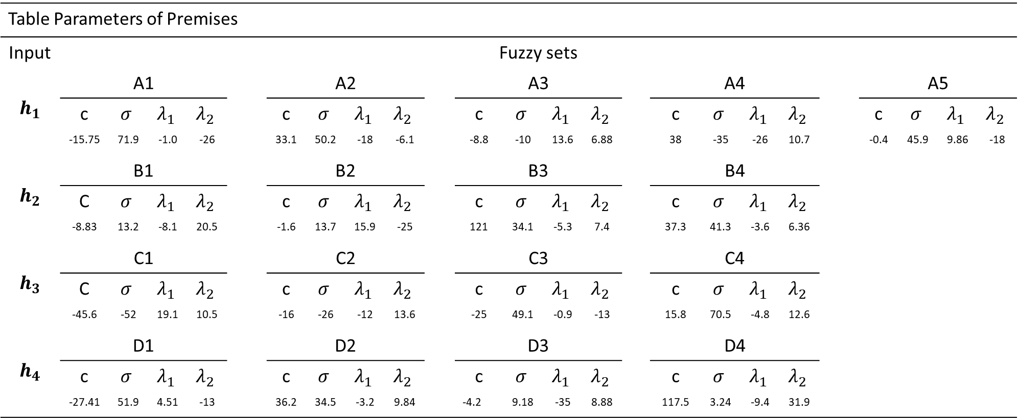
Premises Parameters (after learning)
Experimentation2
Table Parameters of Premises
Input | Fuzzy sets
$$h_{1}$$ | A1 |  |  |  |  | A2 |  |  |  |  | A3 |  |  |  |  | A4 |  |  |  |  |  | A5
 | c | $$σ$$ | $$λ_{1}$$ | $$λ_{2}$$ |  | c | $$σ$$ | $$λ_{1}$$ | $$λ_{2}$$ |  | c | $$σ$$ | $$λ_{1}$$ | $$λ_{2}$$ |  | c |  | $$σ$$ | $$λ_{1}$$ | $$λ_{2}$$ |  | c | $$σ$$ | $$λ_{1}$$ | $$λ_{2}$$
 | -15.75 | 71.9 | -1.0 | -26 |  | 33.1 | 50.2 | -18 | -6.1 |  | -8.8 | -10 | 13.6 | 6.88 |  | 38 |  | -35 | -26 | 10.7 |  | -0.4 | 45.9 | 9.86 | -18
$$h_{2}$$ | B1 |  |  |  |  | B2 |  |  |  |  | B3 |  |  |  |  | B4
 | C | $$σ$$ | $$λ_{1}$$ | $$λ_{2}$$ |  | c | $$σ$$ | $$λ_{1}$$ | $$λ_{2}$$ |  | c | $$σ$$ | $$λ_{1}$$ | $$λ_{2}$$ |  | c |  | $$σ$$ | $$λ_{1}$$ | $$λ_{2}$$
 | -8.83 | 13.2 | -8.1 | 20.5 |  | -1.6 | 13.7 | 15.9 | -25 |  | 121 | 34.1 | -5.3 | 7.4 |  | 37.3 |  | 41.3 | -3.6 | 6.36
$$h_{3}$$ | C1 |  |  |  |  | C2 |  |  |  |  | C3 |  |  |  |  | C4
 | C | $$σ$$ | $$λ_{1}$$ | $$λ_{2}$$ |  | c | $$σ$$ | $$λ_{1}$$ | $$λ_{2}$$ |  | c | $$σ$$ | $$λ_{1}$$ | $$λ_{2}$$ |  | c |  | $$σ$$ | $$λ_{1}$$ | $$λ_{2}$$
 | -45.6 | -52 | 19.1 | 10.5 |  | -16 | -26 | -12 | 13.6 |  | -25 | 49.1 | -0.9 | -13 |  | 15.8 |  | 70.5 | -4.8 | 12.6
$$h_{4}$$ | D1 |  |  |  |  | D2 |  |  |  |  | D3 |  |  |  |  | D4
 | c | $$σ$$ | $$λ_{1}$$ | $$λ_{2}$$ |  | c | $$σ$$ | $$λ_{1}$$ | $$λ_{2}$$ |  | c | $$σ$$ | $$λ_{1}$$ | $$λ_{2}$$ |  | c |  | $$σ$$ | $$λ_{1}$$ | $$λ_{2}$$
 | -27.41 | 51.9 | 4.51 | -13 |  | 36.2 | 34.5 | -3.2 | 9.84 |  | -4.2 | 9.18 | -35 | 8.88 |  | 117.5 |  | 3.24 | -9.4 | 31.9

Slide 42
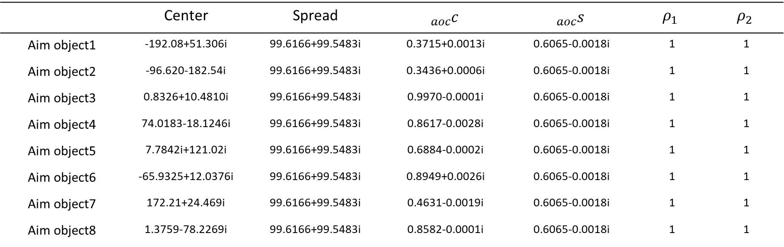
Aim Object Parameters
Layer1 of Aim Object
 | Center | Spread | $${}_{aoc}^{}c$$ | $${}_{aoc}^{}s$$ | $$ρ_{1}$$ | $$ρ_{2}$$
Aim object1 | -192.08+51.306i | 99.6166+99.5483i | 0.3715+0.0013i | 0.6065-0.0018i | 1 | 1
Aim object2 | -96.620-182.54i | 99.6166+99.5483i | 0.3436+0.0006i | 0.6065-0.0018i | 1 | 1
Aim object3 | 0.8326+10.4810i | 99.6166+99.5483i | 0.9970-0.0001i | 0.6065-0.0018i | 1 | 1
Aim object4 | 74.0183-18.1246i | 99.6166+99.5483i | 0.8617-0.0028i | 0.6065-0.0018i | 1 | 1
Aim object5 | 7.7842i+121.02i | 99.6166+99.5483i | 0.6884-0.0002i | 0.6065-0.0018i | 1 | 1
Aim object6 | -65.9325+12.0376i | 99.6166+99.5483i | 0.8949+0.0026i | 0.6065-0.0018i | 1 | 1
Aim object7 | 172.21+24.469i | 99.6166+99.5483i | 0.4631-0.0019i | 0.6065-0.0018i | 1 | 1
Aim object8 | 1.3759-78.2269i | 99.6166+99.5483i | 0.8582-0.0001i | 0.6065-0.0018i | 1 | 1
Notes:
Radius:
0.0626
0.9724
0.6032
0.9479
0.3660

Slide 43
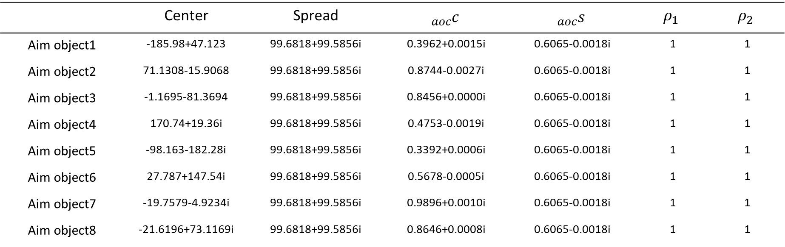
Aim Object Parameters
Layer2 of Aim Object
 | Center | Spread | $${}_{aoc}^{}c$$ | $${}_{aoc}^{}s$$ | $$ρ_{1}$$ | $$ρ_{2}$$
Aim object1 | -185.98+47.123 | 99.6818+99.5856i | 0.3962+0.0015i | 0.6065-0.0018i | 1 | 1
Aim object2 | 71.1308-15.9068 | 99.6818+99.5856i | 0.8744-0.0027i | 0.6065-0.0018i | 1 | 1
Aim object3 | -1.1695-81.3694 | 99.6818+99.5856i | 0.8456+0.0000i | 0.6065-0.0018i | 1 | 1
Aim object4 | 170.74+19.36i | 99.6818+99.5856i | 0.4753-0.0019i | 0.6065-0.0018i | 1 | 1
Aim object5 | -98.163-182.28i | 99.6818+99.5856i | 0.3392+0.0006i | 0.6065-0.0018i | 1 | 1
Aim object6 | 27.787+147.54i | 99.6818+99.5856i | 0.5678-0.0005i | 0.6065-0.0018i | 1 | 1
Aim object7 | -19.7579-4.9234i | 99.6818+99.5856i | 0.9896+0.0010i | 0.6065-0.0018i | 1 | 1
Aim object8 | -21.6196+73.1169i | 99.6818+99.5856i | 0.8646+0.0008i | 0.6065-0.0018i | 1 | 1
Notes:
Radius:
0.0626
0.9724
0.6032
0.9479
0.3660

Slide 44
Consequences Parameters
$$\text{θ}=$$

Slide 45
Learning Curve
Experimentation2

Slide 46
Experimentation2

Slide 47
Comparison
Experimentation2
Performance comparison in RMSE(DJAI)
Method Year | 2001 | 2002 | 2003 | 2004
SVR (two models, each with single output) | 101.44 | 117.95 | 82.76 | 71.49
ANFIS (two models, each with single output) | 105.56 | 111.69 | 72.09 | 68.00
ANFIS (one model with two output) | 128.20 | 142.05 | 90.37 | 83.69
RBF (two models, each with single output) | 106.33 | 131.24 | 97.58 | 81.79
RBF (one model with two output) | 181.79 | 136.28 | 154.14 | 148.11
CNFS(5)-ARIMA (one model with two output) | 103.06 | 103.42 | 70.70 | 66.55
SCNFS | 89.59 | 86.81 | 55.35 | 60.3
Performance comparison in RMSE(TAIEX)
Method Year | 2001 | 2002 | 2003 | 2004
SVR (two models, each with single output) | 162.46 | 67.72 | 59.47 | 58.81
ANFIS (two models, each with single output) | 147.36 | 70.17 | 72.61 | 65.33
ANFIS (one model with two output) | 151.62 | 78.27 | 81.69 | 70.54
RBF (two models, each with single output) | 134.32 | 65.15 | 60.41 | 102.86
RBF (one model with two output) | 137.58 | 78.54 | 115.92 | 126.48
CNFS(5)-ARIMA (one model with two output) | 115.82 | 64.34 | 57.69 | 55.56
SCNFS | 94.31 | 85.52 | 56.26 | 61.65

Slide 48
Experimentation3

Slide 49
Data
Experimentation3
Experimentation3
 | Training | Testing
APPLE Computer Inc. | 02/10/2003~09/10/2004 | 09/13/2004~01/21/2005
IBM Corporation. | 02/10/2003~09/10/2004 | 09/13/2004~01/21/2005
Dell Inc. | 02/10/2003~09/10/2004 | 09/13/2004~01/21/2005
Microsoft Inc. | 02/10/2003~09/10/2004 | 09/13/2004~01/21/2005
433
59

Slide 50

Result
Experimentation3
Parameter | Value
Number of inputs | {$f_{73} f_{84} f_{71} f_{81}$ }
Number of fuzzy sets of each input | 3、3、3、3
Number of targets (real-valued) | 4
Number of outputs (complex-valued) | 2
Number of premises (before selection) | 81
Type of premises | Sphere complex fuzzy set
Number of premises (after selection) | 9
Number of premise parameters | 48
Number of aim object | 3
Type of consequences | Takagi-sugeno
Number of consequences | 3
Number of consequence parameters | 15

Slide 51
Experimentation3
PSO parameters
Parameters | value
Swarm size | 64
Iterations | 100
$ω c_{1} 、c_{2}$ | 0.8 2.0 2.0
$ξ_{1}、ξ_{2}$ | Random in [0,1]
Velocity | 0
RLSE parameters
Parameters | value
$α$ | ${1×10}^{8}$
${\overset{⃑}{\text{θ}}}_{0}$ | 20x1 zero vector
$P_{0}$ | $α$I
I | 20x20 identify matrix

Slide 52
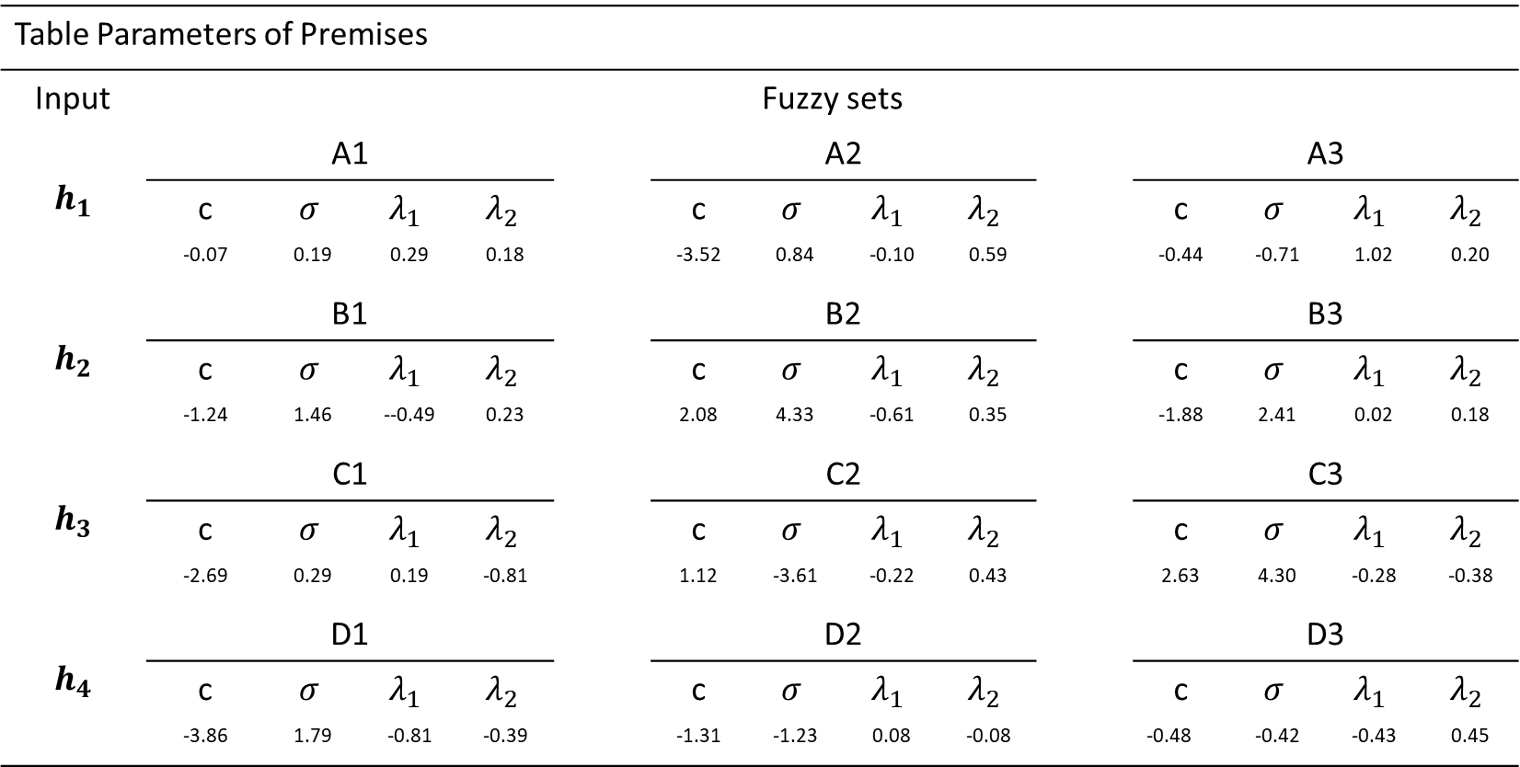
Premises Parameters (after learning)
Experimentation3
Table Parameters of Premises
Input | Fuzzy sets
$$h_{1}$$ | A1 |  |  |  |  | A2 |  |  |  |  | A3
 | c | $$σ$$ | $$λ_{1}$$ | $$λ_{2}$$ |  | c | $$σ$$ | $$λ_{1}$$ | $$λ_{2}$$ |  | c | $$σ$$ | $$λ_{1}$$ | $$λ_{2}$$
 | -0.07 | 0.19 | 0.29 | 0.18 |  | -3.52 | 0.84 | -0.10 | 0.59 |  | -0.44 | -0.71 | 1.02 | 0.20
$$h_{2}$$ | B1 |  |  |  |  | B2 |  |  |  |  | B3
 | c | $$σ$$ | $$λ_{1}$$ | $$λ_{2}$$ |  | c | $$σ$$ | $$λ_{1}$$ | $$λ_{2}$$ |  | c | $$σ$$ | $$λ_{1}$$ | $$λ_{2}$$
 | -1.24 | 1.46 | --0.49 | 0.23 |  | 2.08 | 4.33 | -0.61 | 0.35 |  | -1.88 | 2.41 | 0.02 | 0.18
$$h_{3}$$ | C1 |  |  |  |  | C2 |  |  |  |  | C3
 | c | $$σ$$ | $$λ_{1}$$ | $$λ_{2}$$ |  | c | $$σ$$ | $$λ_{1}$$ | $$λ_{2}$$ |  | c | $$σ$$ | $$λ_{1}$$ | $$λ_{2}$$
 | -2.69 | 0.29 | 0.19 | -0.81 |  | 1.12 | -3.61 | -0.22 | 0.43 |  | 2.63 | 4.30 | -0.28 | -0.38
$$h_{4}$$ | D1 |  |  |  |  | D2 |  |  |  |  | D3
 | c | $$σ$$ | $$λ_{1}$$ | $$λ_{2}$$ |  | c | $$σ$$ | $$λ_{1}$$ | $$λ_{2}$$ |  | c | $$σ$$ | $$λ_{1}$$ | $$λ_{2}$$
 | -3.86 | 1.79 | -0.81 | -0.39 |  | -1.31 | -1.23 | 0.08 | -0.08 |  | -0.48 | -0.42 | -0.43 | 0.45

Slide 53
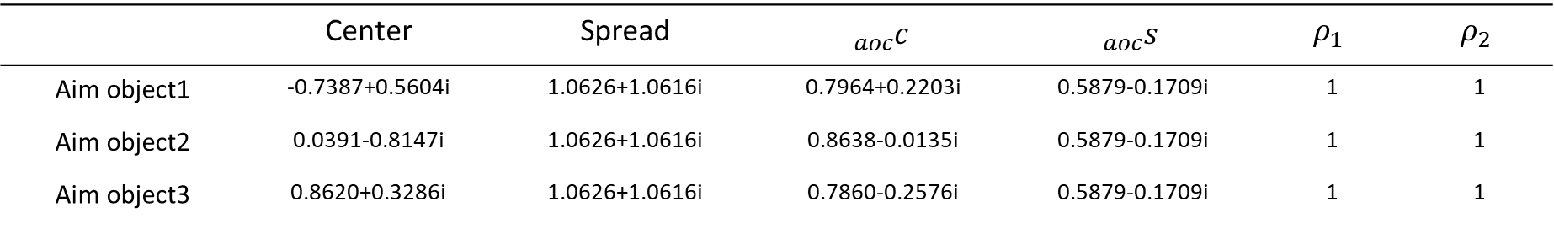
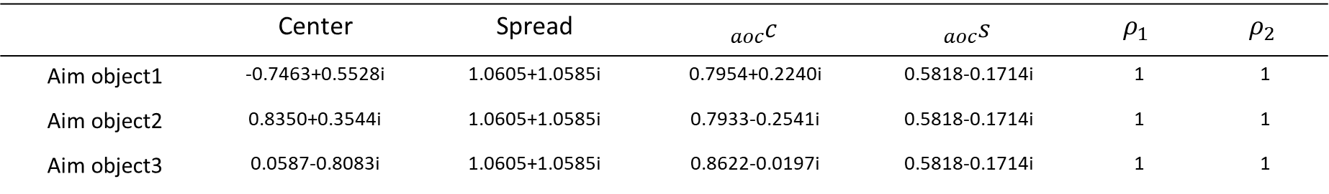
Aim Object Parameters
Layer1 of Aim Object
 | Center | Spread | $${}_{aoc}^{}c$$ | $${}_{aoc}^{}s$$ | $$ρ_{1}$$ | $$ρ_{2}$$
Aim object1 | -0.7387+0.5604i | 1.0626+1.0616i | 0.7964+0.2203i | 0.5879-0.1709i | 1 | 1
Aim object2 | 0.0391-0.8147i | 1.0626+1.0616i | 0.8638-0.0135i | 0.5879-0.1709i | 1 | 1
Aim object3 | 0.8620+0.3286i | 1.0626+1.0616i | 0.7860-0.2576i | 0.5879-0.1709i | 1 | 1
Layer2 of Aim Object
 | Center | Spread | $${}_{aoc}^{}c$$ | $${}_{aoc}^{}s$$ | $$ρ_{1}$$ | $$ρ_{2}$$
Aim object1 | -0.7463+0.5528i | 1.0605+1.0585i | 0.7954+0.2240i | 0.5818-0.1714i | 1 | 1
Aim object2 | 0.8350+0.3544i | 1.0605+1.0585i | 0.7933-0.2541i | 0.5818-0.1714i | 1 | 1
Aim object3 | 0.0587-0.8083i | 1.0605+1.0585i | 0.8622-0.0197i | 0.5818-0.1714i | 1 | 1
Notes:
Radius:
0.0626
0.9724
0.6032
0.9479
0.3660

Slide 54
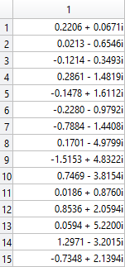
Consequences Parameters
$$\text{θ}=$$

Slide 55
Learning Curve
Experimentation3

Slide 56
Experimentation3

Slide 57
Comparison
Experimentation3
Performance comparison in MAPE
 | APPLE | IBM | DELL
HiMMI | 2.8373 | 1.2186 | 1.0117
ANN-GA-HMM-Interpolation | 2.1649 | 1.0555 | 0.8446
ANN-GA-HMM-WA | 1.9247 | 0.8487 | 0.6992
ARIMA | 1.8009 | 0.9723 | 0.6604
SCNFS | 0.6760 | 0.6563 | 0.6507

